Slide 1

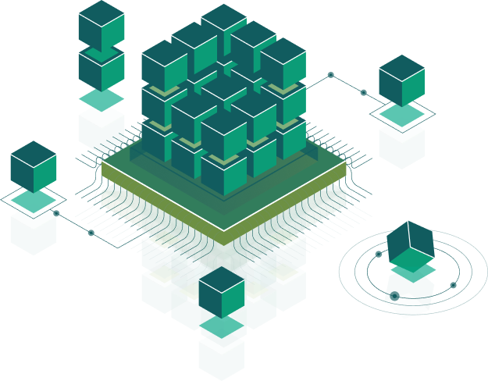
Intro Android
Speaker:
Andrii Rudyk

Slide 2

What is Android?
It’s an open source and we can customize it
It support a connectivity for GSM, CDMA, WIFI, NFC, Bluetooth, etc.
By using WIFI technology we can pair with other devices
A multiple APIs to support GPS
SQLite Database
A wide range of media supports like AVI, MKV, FLV, MPEG4 etc.
It has an extensive support for multimedia hardware control to perform playback or recording using camera and microphone
It has an integrated open source webkit layout based web browser to support HTML5, CSS3
It supports a multi-tasking, we can move from one task window to another and multiple applications can run simultaneously
It has a support for 2D/3D Graphics

Slide 3
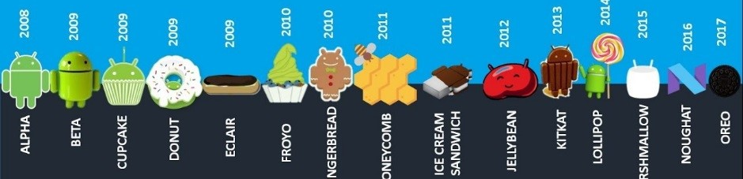
History of Android

Slide 4
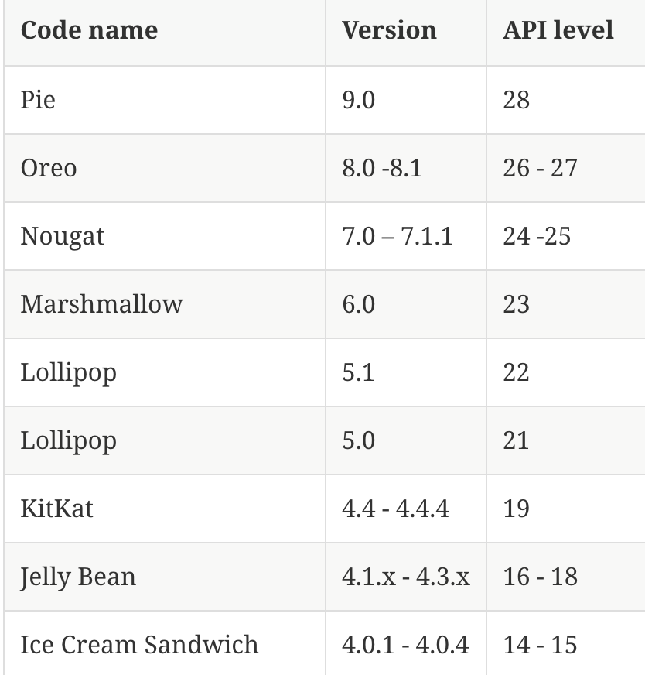
What is API level?
API Level is an integer value that uniquely identifies the framework API revision offered by a version of the Android platform.

Slide 5
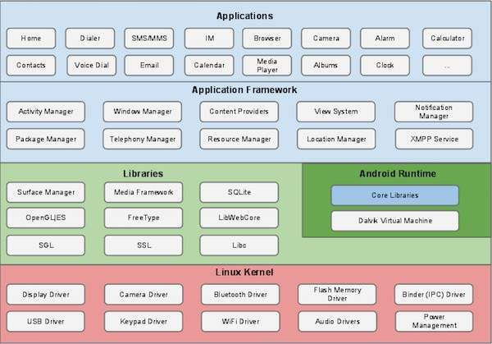
Android - Architecture
Applications - Browser, Camera, Gallery, Music and Phone
Application framework - allows high-level interactions with the Android system (Activity Manager, Content Providers, Resource Manager, Notifications Manager)
Libraries and runtime - graphic rendering, data storage, web browsing. Also contains the Android runtime, as well as the core Java libraries for running Android applications.
Linux kernel - Communication layer for the underlying hardware.

Slide 6
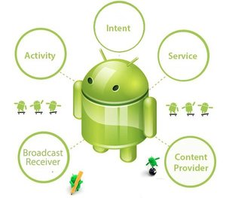
Application Components
Activity
Fragment
Service
Broadcast Receiver
Content Provider
Intent

Slide 7
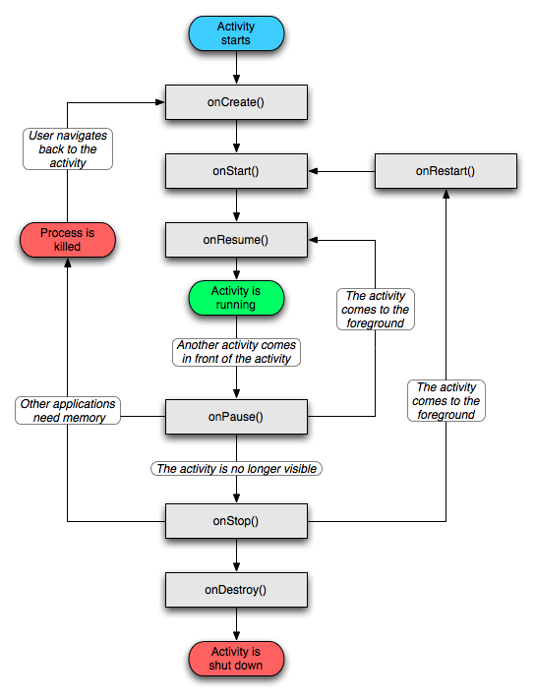
Activity
An activity is the visual representation of an Android application. An Android application can have several activities.
Activities use views and fragments to create their user interface and to interact with the user.

Slide 8
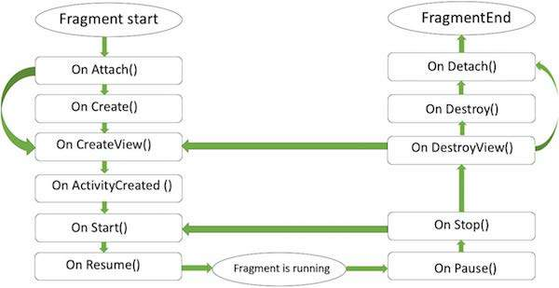
Fragment
A fragment has its own layout and its own behaviour with its own life cycle callbacks.
You can add or remove fragments in an activity while the activity is running.
You can combine multiple fragments in a single activity to build a multi-pane UI.
A fragment can be used in multiple activities.
Fragment life cycle is closely related to the life cycle of its host activity which means when the activity is paused, all the fragments available in the activity will also be stopped.
A fragment can implement a behaviour that has no user interface component.
Fragments were added to the Android API in Honeycomb version of Android which API version 11.

Slide 9
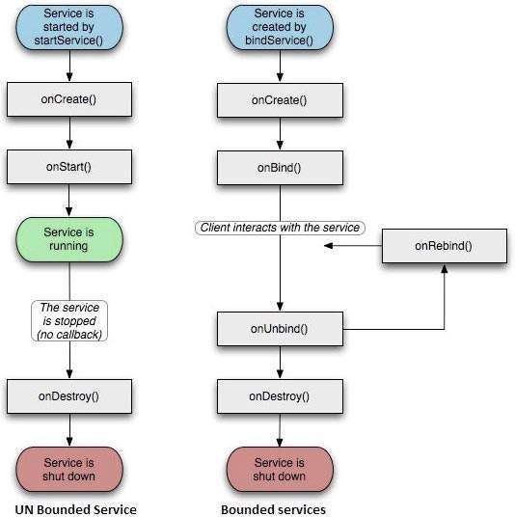
Service
A service performs tasks without providing an user interface. They can communicate with other Android components and send notifications to the user. For example, a broadcast receiver can notify the user via the notification framework in Android.

Slide 10
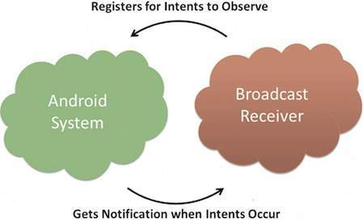
Broadcast Receiver
A receiver can be registered to listen to system messages and intents. A receiver gets notified by the Android system if the specified event occurs. For example, you can register a receiver for the event that the Android system finished the boot process. Or you can register for the event that the state of the phone changes, e.g., someone is calling.

Slide 11
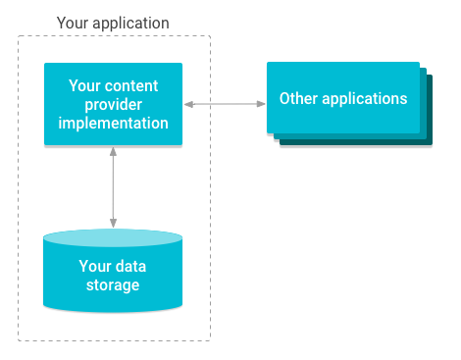
Content provider
A provider defines a structured interface to application data. A provider can be used for accessing data within one application, but can also be used to share data with other applications.

Slide 12
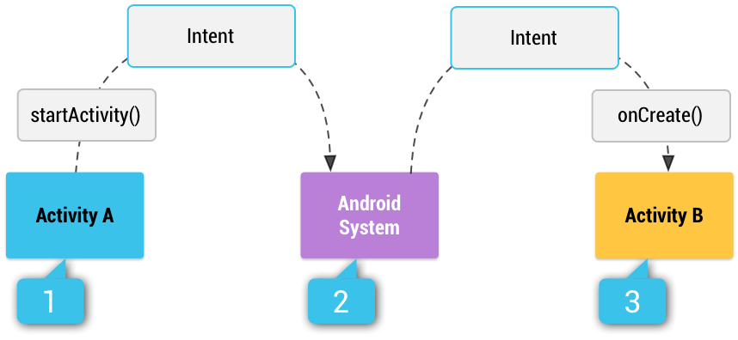
Intent
An Android Intent is an abstract description of an operation to be performed. It can be used with startActivity to launch an Activity, broadcastIntent to send it to any interested BroadcastReceiver components, and startService(Intent) or bindService(Intent, ServiceConnection, int) to communicate with a background Service.

Slide 13

Additional components
Views - UI elements that are drawn on-screen including buttons, lists forms etc.
Layouts - View hierarchies that control screen format and appearance of the views.
Resources - External elements, such as strings, constants and drawable pictures.
Manifest - Configuration file for the application.

Slide 14

Thank you!

